Slide 1

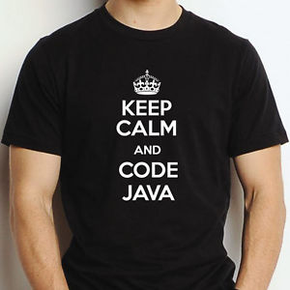

Java Overview
Dimitar Ivanov
Telerik Software Academy
Learning & Development
http://academy.telerik.com

Slide 2

Table of Contents
What is java ?
Java language
Java features (1)(2)(3)
Java disadvantages
Time to code
Language basics

Slide 3

What is java ?
Developed by Sun Microsystems
Based on C/C++
A general-purpose object-oriented language
Designed for easy Web/Internet applications
Widespread acceptance

Slide 4
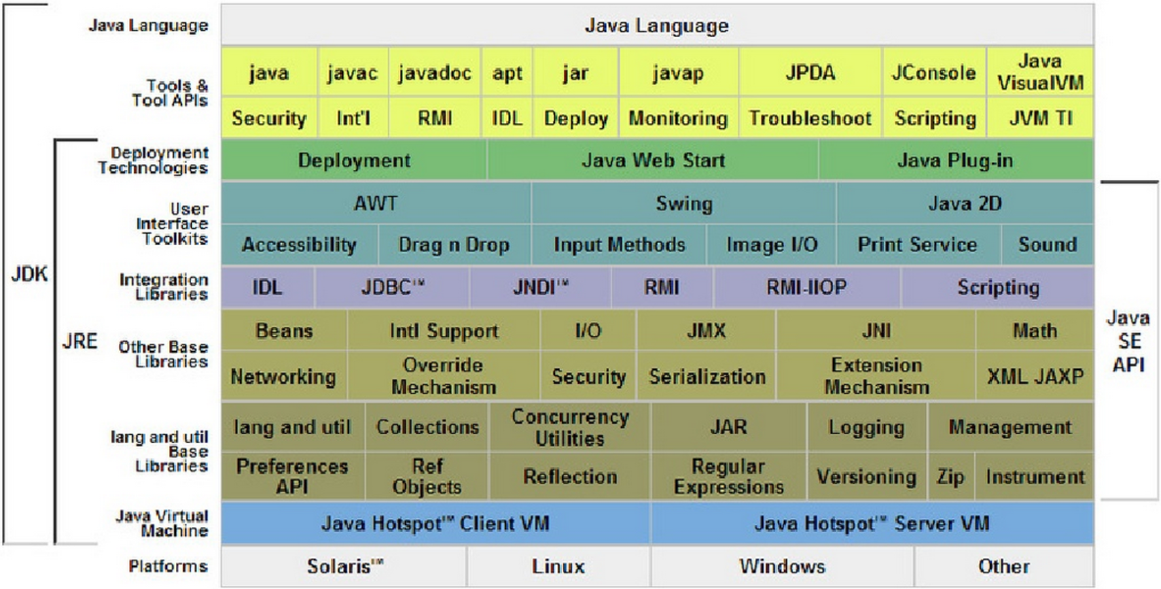
Java language

Slide 5
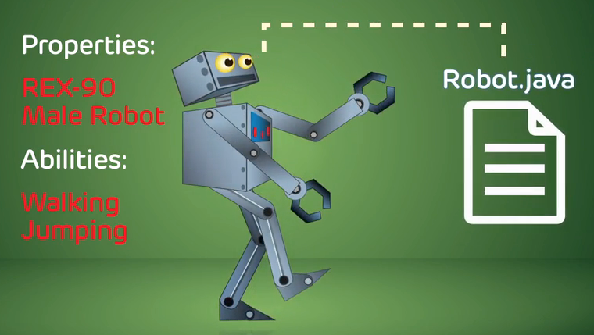
Java Features
Simple
Fixes some clumsy things in C++
No pointers (yeah ….)
Automatic garbage collector
Rich pre-defined class library
Object - oriented
Focus on the data (the objects) and methods manipulating the data
All functions are objects (or associated with them)
Almost all data types are objects (files,strings,etc.)
Potentially better code organization and reuse

Slide 6
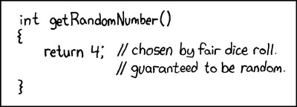
Java Features
Interpreted
Java compile generate byte-codes, not native machine code
Compiled byte-codes are platform-independent
Java byte codes are easy translated to machine readable instructions in runtime (JVM)
Portable
Same application runs on all platforms
Sizes of the primitive data types are always the same
Libraries define portable interfaces

Slide 7
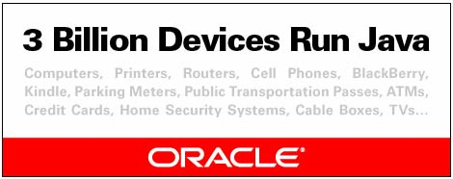
Java Features
Reliable
Compile time and runtime error checking
No shitty pointers instead real arrays. (Memory corruptions or unauthorized memory accesses are impossible)
Automatic garbage collection tracks objects usage over time
Secure
Using it inside networked environment requires more security
Memory allocation model is a major defense
Access restrictions are forced a.k.a private or public

Slide 8
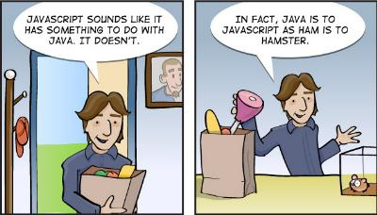
Java Features
Dynamic
You can check the class/data type in runtime
Interfaces are flexible and reusable.
Automatic garbage collection tracks objects usage over time

Slide 9
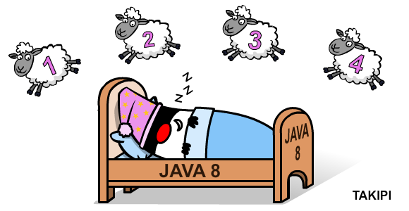
Java Disadvantages
Slower than compiled language such as C/C++
Java is 3 or 4 times slower than C/C++
Adequate for all but the most time-intensive programs

Slide 10

Let’s code

Slide 11
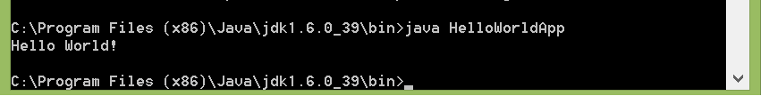
Hello world
/**
* The HelloWorldApp class implements an application that
* simply prints "Hello World!" to standard output.
*/
class HelloWorldApp {
public static void main(String[] args) {
System.out.println("Hello World!"); // Display the string.
}
}

Slide 12
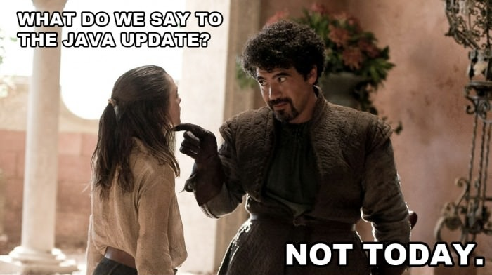
Java Basic Flow
Host
System
JVM
Byte code
Source code

Slide 13
Language basics
Data types
8 primitive types:
Boolean, byte, short, int, long, float, double, char
Class types, either provided by Java, or made by programmers
String, Integer, Array, Frame, Object, Person, Animal, …
Array types
Variables
dataType identifier [ = Expression]:
Example variable declations and initializations:
Int x; x = 5;
Boolean b = false;
Int[] intArray = new int[2];
Person pArray = new Person[10];

Slide 14
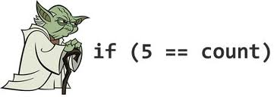
Language basics
Flow of control
If,if-else,if-else if
Switch
For,while,do-while
Break
continue

Slide 15
Java Overview
http://academy.telerik.com

Slide 16




Free Trainings @ Telerik Academy
C# Programming @ Telerik Academy
csharpfundamentals.telerik.com
Telerik Software Academy
academy.telerik.com
Telerik Academy @ Facebook
facebook.com/TelerikAcademy
Telerik Software Academy Forums
forums.academy.telerik.com

